Slide 1

Inversiones en Energía, S.A. de C.V.
Presentation Template

Slide 2
Ganancia
Q8,514,077.00

Slide 3
Q2,803,617
Q5,380,176

Slide 4
Costo
Q28,174,018.9
36,688,096
Ganancia
Q8,514,077.00

Slide 5
Distribución de vehículos
1

Slide 6
Camión 62,267
Pickup 195,733
Moto 5,725

Slide 7
Tarifario de
Uso por vehículo
Camión: Q184
Pickup: Q125.2
Moto: Q126.46

Slide 8
Notes:
Podemos ver que el vehículo que más se usa independientemente de la altura del poste es el PickUp

Slide 9
Notes:
Podemos ver que los vehículos usan notablemente mas las ubicaciones 224 y la 0277.

Slide 10
Notes:
Esta grafica nos muestra que el pickup es el vehículo que se usa más para todas los motivos de visita excepto por el motivo de ‘correccion’ donde el camión es sumamente superior y el apartado ‘otros’. Una vez más el vehículo de motocicleta no representa ningún dato importante. Realizó mas visitas que el pickup por cambio de fusuble pero menos que el camion

Slide 11
Notes:
El pickup es una vez más el que más se usa, esta vez medido en tiempo. El camion solo se usa más cuando las visitas son de 120 minutos o más. Este motivo puede ser explicado con la gráfica anterior, que explica que el camion se usa mucho más para visitas de correción. Puede ser que ese tipo de visitas sea muy tardado y el equipo muy grande y por eso tienen que ir en camion.

Slide 12
Distribucion clientes importanets

Slide 13
¡Gracias!
¿Alguna pregunta?

Slide 14
Content in two columns
Content A
Content B
Content itself is what the end-user derives value from also can refer to the information provided through the medium, the way in which
Content itself is what the end-user derives value from also can refer to the information provided through the medium, the way in which

Slide 15
Content in three columns
Content A
Content B
Content C
Content itself is what the end-user derives value from also can refer to the information provided through the medium,
Content itself is what the end-user derives value from also can refer to the information provided through the medium,
Content itself is what the end-user derives value from also can refer to the information provided through the medium,

Slide 16

A Picture Is Worth A Thousand Words
Itself is what the end-user derives value from also.

Slide 17

Use Big Images
To Show
Your Ideas

Slide 18
Shapes to
explain ideas
TITLE 01
TITLE 03
TITLE 02

Slide 19
Features With icons
Service 01
Service 02
Service 03

Slide 20
Tables to compare data
 | A | B | C
Content A | 100 | 200 | 400
Content B | $67,000 | $56,000 | $78,000
Content C | 4500 | 60000 | $8,000

Slide 21
World Map
USA
19,450000
EUROPE
19,450000
BRASIL
19,450000

Slide 22
56,790,500
Write here your big numbers

Slide 23
Funny facts
56,790,500
130%
56,790,500
Revenue from sales
Project Achievements
Users around the world

Slide 24
The process
Step 01
Step 02
Step 03

Slide 25
Features with icons
Content A
Content B
Content B
Itself is what the end-user derives value from also can refer to the information
Itself is what the end-user derives value from also can refer to the information
Itself is what the end-user derives value from also can refer to the information
Content C
Content D
Content D
Itself is what the end-user derives value from also can refer to the information
Itself is what the end-user derives value from also can refer to the information
Itself is what the end-user derives value from also can refer to the information

Slide 26
Use Charts to
Present data
86%
59%
50%
37%
Q1
Q2
Q3
Q4

Slide 27
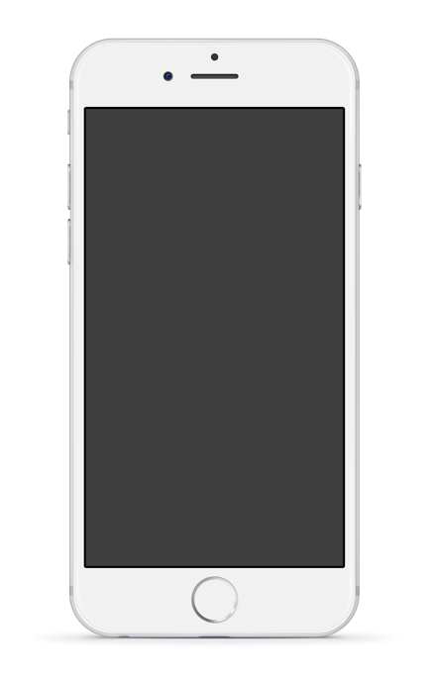

Mobile
App 1
Mobile
App 2
Itself is what the end-user derives value from also can refer is what
Itself is what the end-user derives value from also can refer is what

Slide 28

Laptop
Project
Itself is what the end-user derives value from also can refer.

Slide 29

Desktop
Project
Itself is what the end-user derives value from also can refer is what.

Slide 30
Credits
Special thanks to all people who made and share these awesome resources for free:
Presentation template designed by powerpointify.com
Photographs unsplash.com
Triangles by freepik.com

Slide 31
Presentation Design
This presentation uses the following typographies and colors:
Free Fonts used:
https://www.fontsquirrel.com/fonts/montserrat
Colors used

